Slide 1
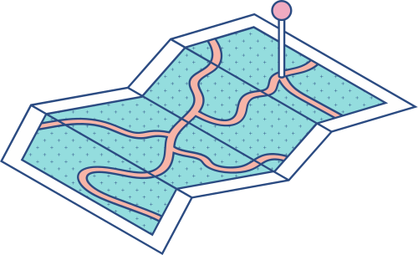





Sustainable Development Goal:
Quality Education
Problem Statement: Many students lack access to the best resources for studying their chosen subjects, leading to inefficient learning and poor educational outcomes.
Rationale: By improving access to quality educational resources and guidance, we can enhance students' learning experiences and outcomes, contributing to the goal of quality education.

Slide 2


Tool Used for Project Design
TOOLS USED FOR PROJECT DESIGN 1. IBM WATSON ASSISTANT 2. Astrojs & Tailwind CSS
IBM Watson Assistant is an AI-powered virtual assistant that understands and responds to user queries using advanced natural language processing. Astrojs: Astro is a modern static site generator that allows you to build fast, optimized websites. It supports multiple front-end frameworks and focuses on delivering minimal JavaScript to improve performance. Tailwind CSS: Tailwind CSS is a utility-first CSS framework that provides low-level utility classes to build custom designs quickly and efficiently. It allows for rapid styling directly in your HTML.

Slide 3
IBM WATSON ASSISTANT
Features:
Natural Language Processing (NLP)
Reliable and efficient in handling large volumes of queries
Why Chosen:
Its advanced capabilities and reliability make it ideal for developing an AI chatbot that can provide personalized educational guidance.
Astrojs & Tailwind CSS
Minimal JavaScript and Island Architecture: Astro.js optimizes website performance by minimizing JavaScript sent to the browser and allows integration of multiple front-end frameworks within a single project for flexibility.?
Tailwind CSS - Utility-First Approach and Responsive Design: Tailwind CSS enables rapid and efficient styling with utility classes directly in HTML and provides built-in responsive classes for designs that adapt to various screen sizes.
Why Chosen:
Astrojs: Allowed Team to develop a website using modern web technologies like MDX
Tailwind CSS: Facilitated Responsive design with pre-build design pattern.

Slide 4







Model Solution and Effectiveness

Slide 5

Solution:
EduWisely: an educational website integrated with an AI Virtual Assistant named 'EduViser'.
Key features:-
Subject Resource Recommendations
Resource Information
Navigation Assistance
Effectiveness: The AI chatbot provides resources, enabling students to make decisions and improve their learning efficiency.

Slide 6

Data
Purpose Of Data:
The data we have used is largely qualitative in nature and its purpose is to train our Virtual Assistant to provide educational resources in a streamlined manner
Data Source: YouTube links free e-books available online

Slide 7


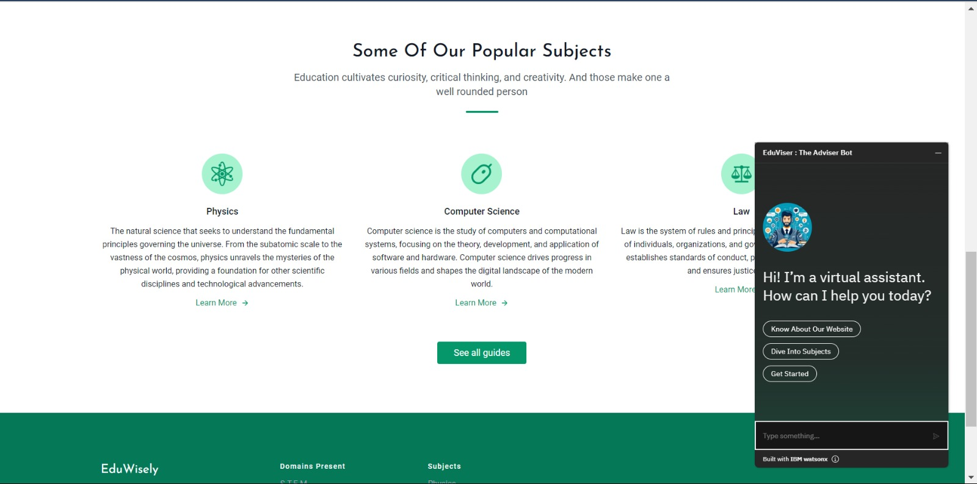
Model Link and Screenshots
LINK : https://eduwisely.netlify.app/

Slide 8
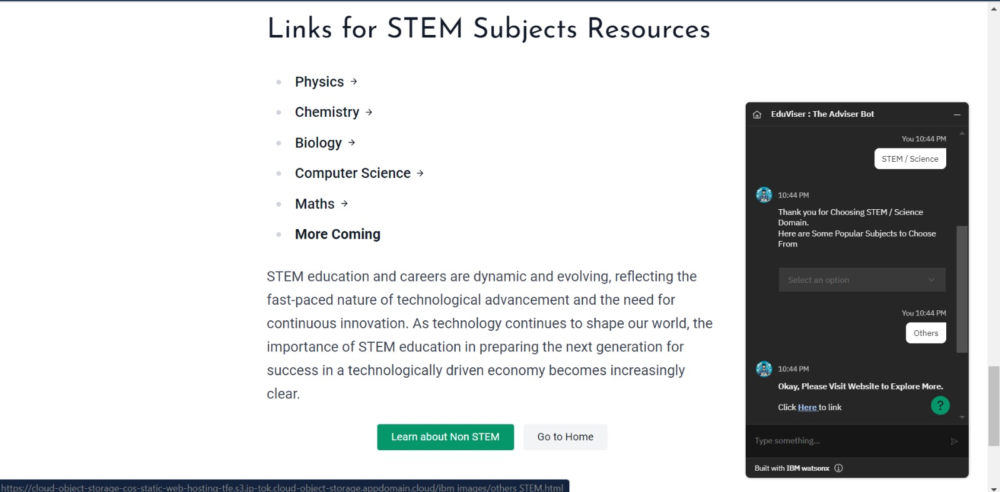
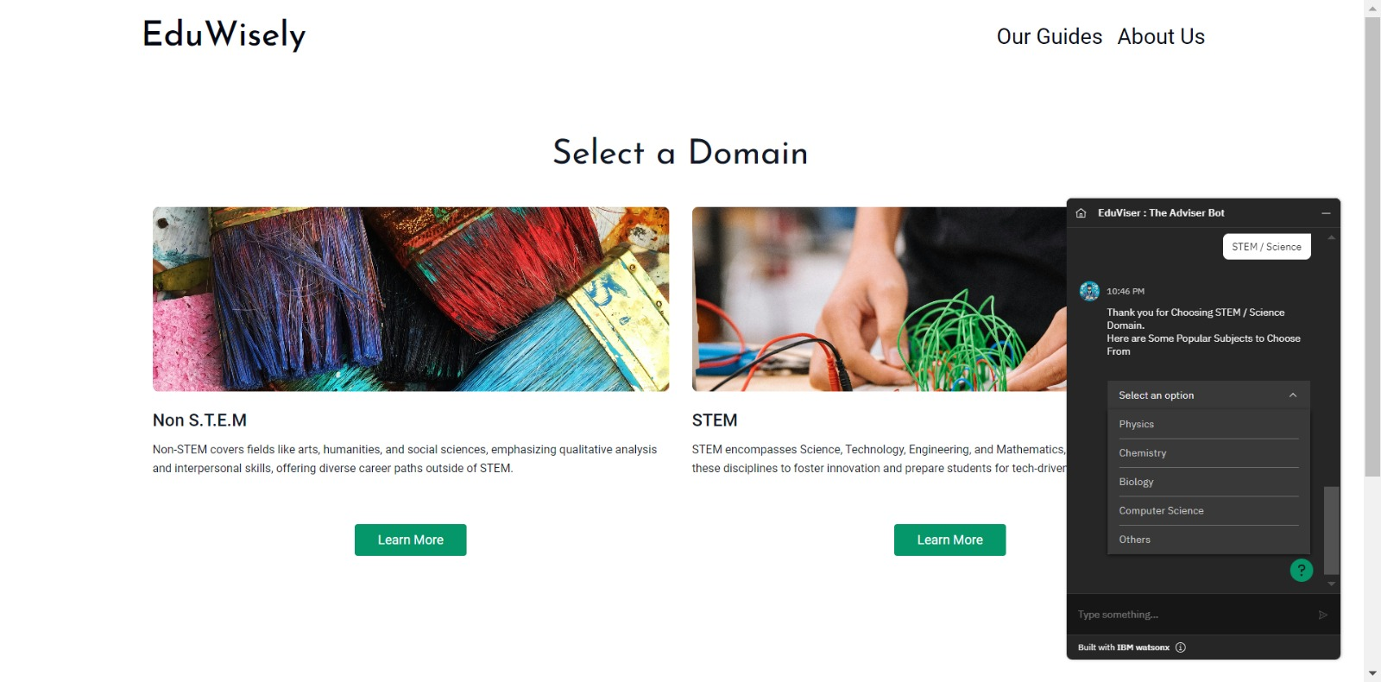

Slide 9
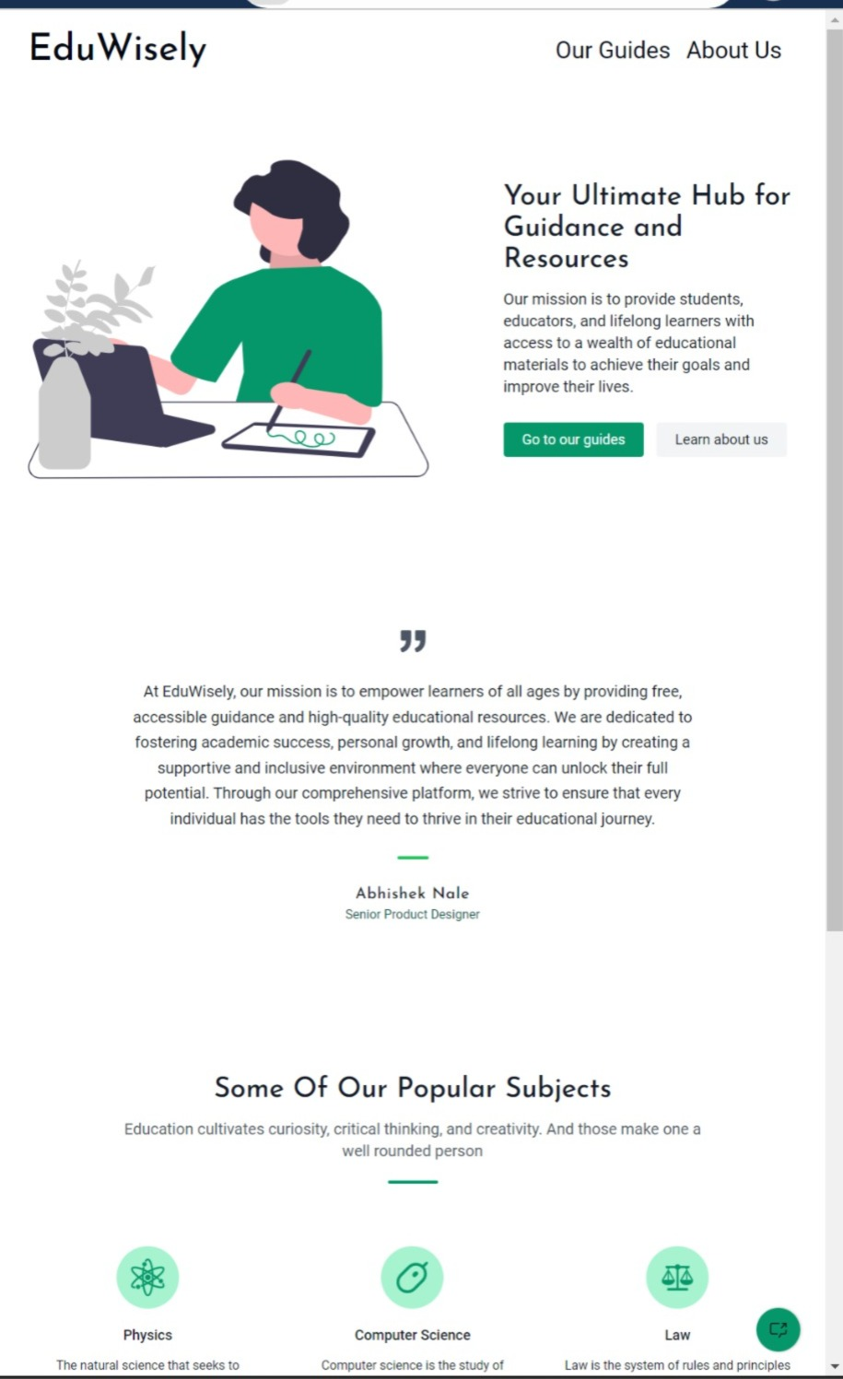
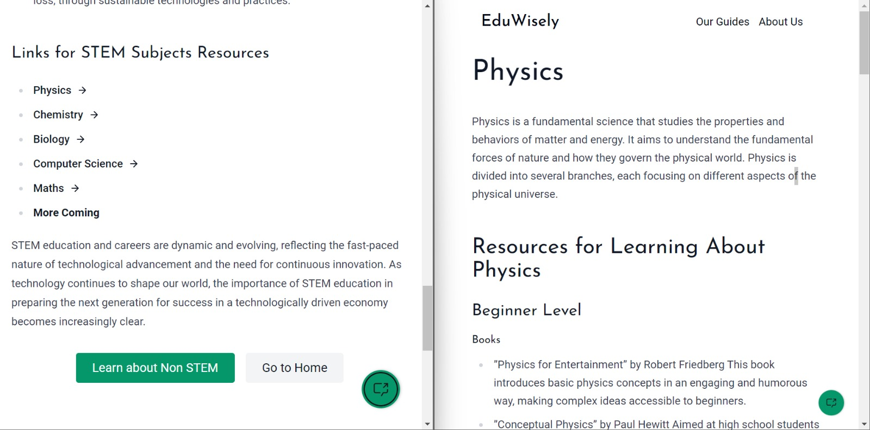

Slide 10
THANK YOU

